Slide 1
REGRESSION
ANALYSIS
Notes:
https://www.youtube.com/watch?v=owI7zxCqNY0
https://www.youtube.com/watch?v=8PJ24SrQqy8 – PROF SUDEHSHNA SARKAR

Slide 2


Slide 3
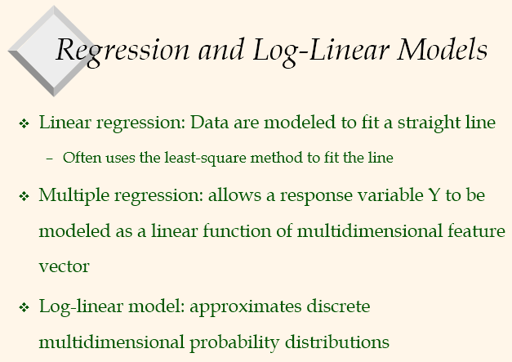

Slide 4


Slide 5


Slide 6
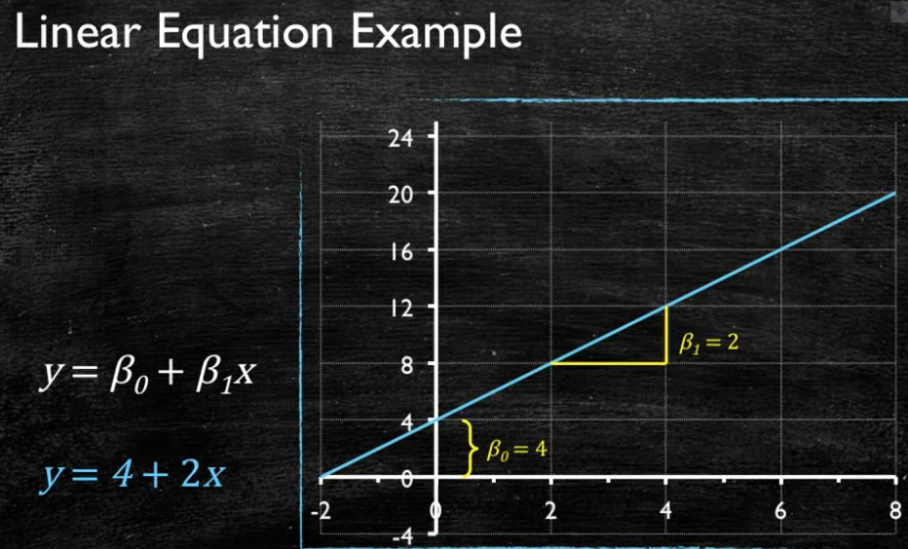

Slide 7
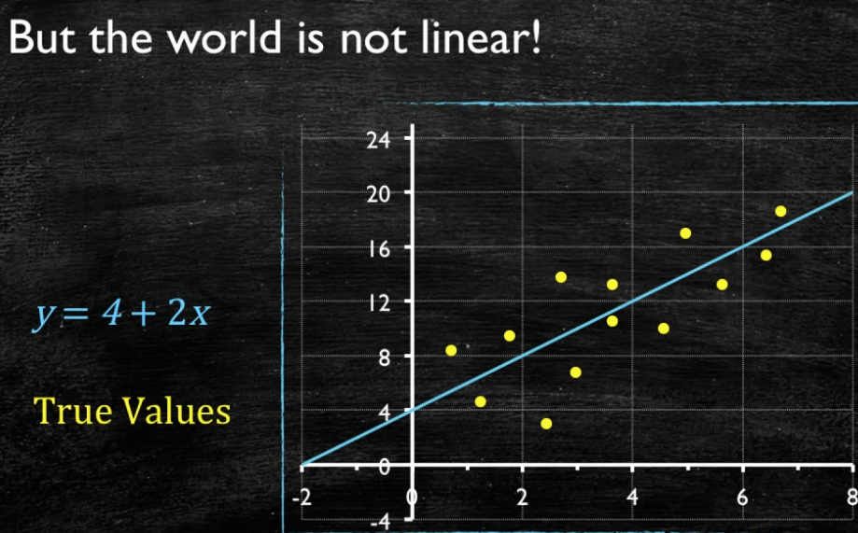

Slide 8
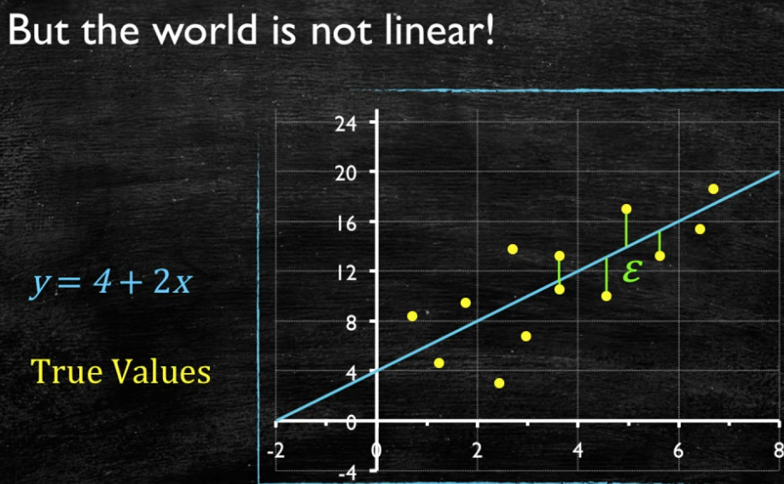

Slide 9
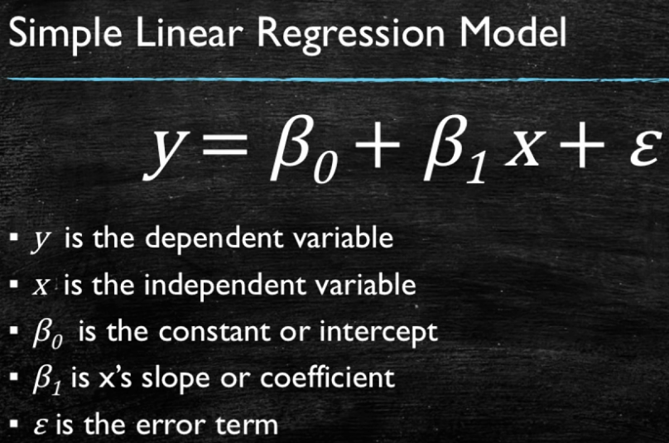

Slide 10
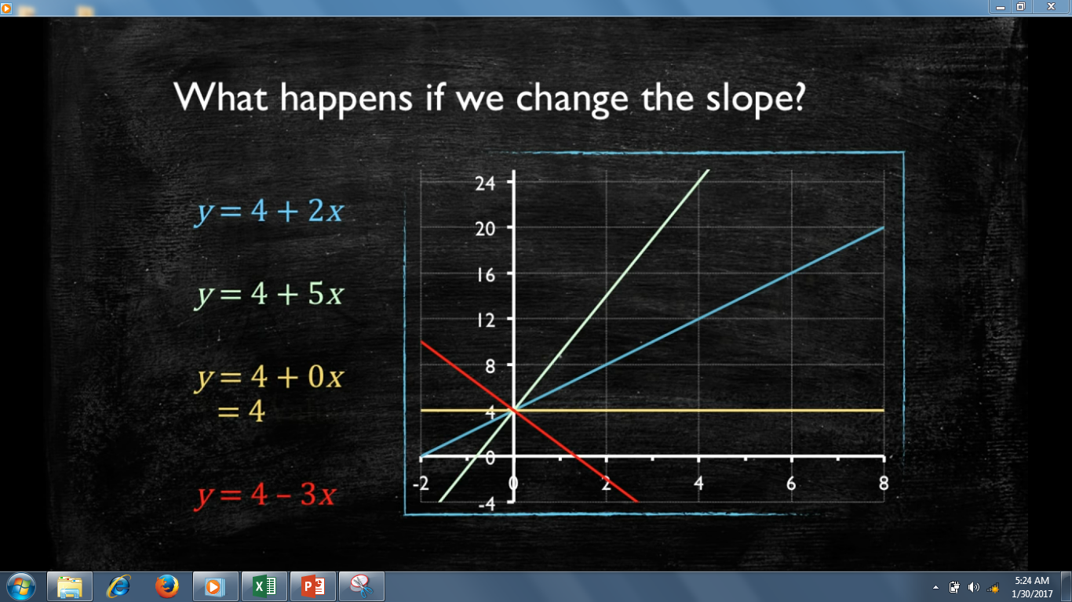

Slide 11


Slide 12
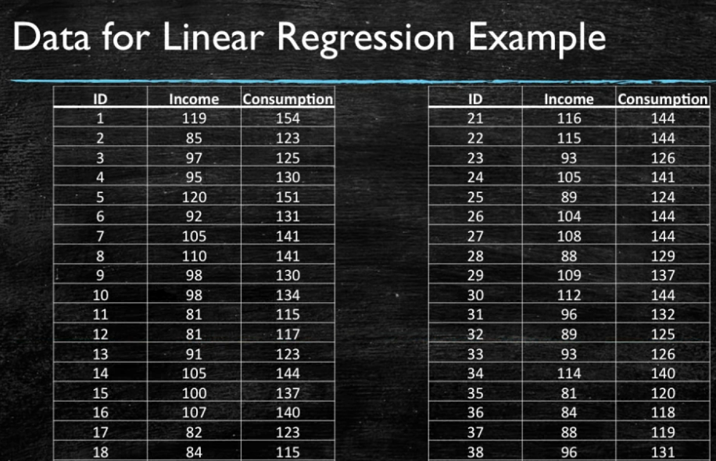

Slide 13
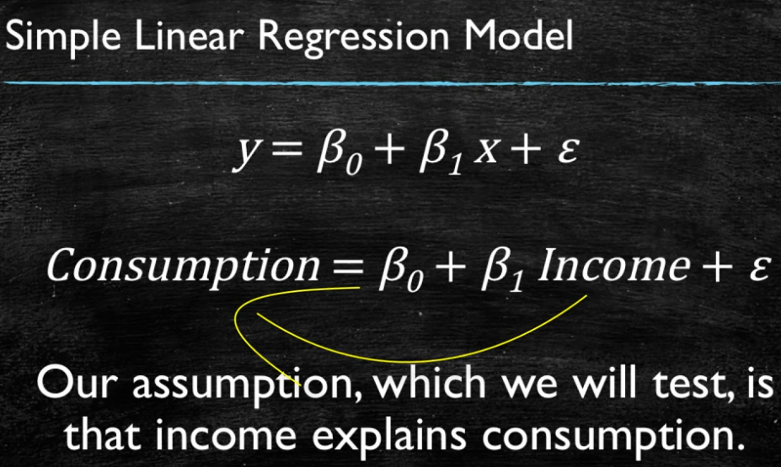

Slide 14
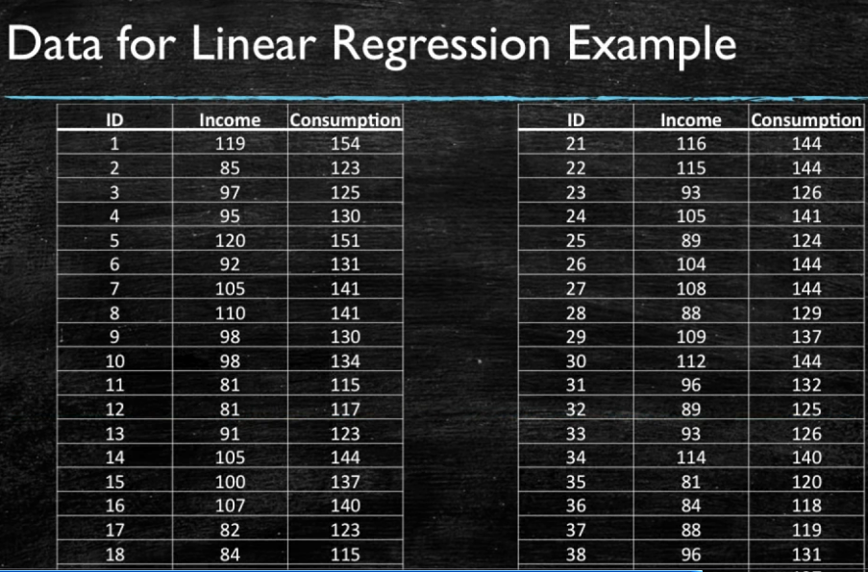
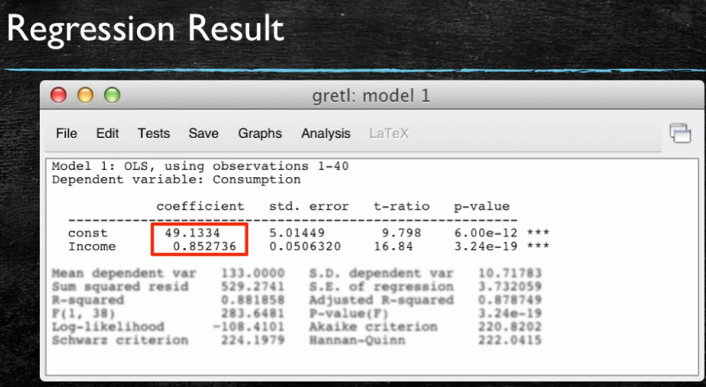

Slide 15
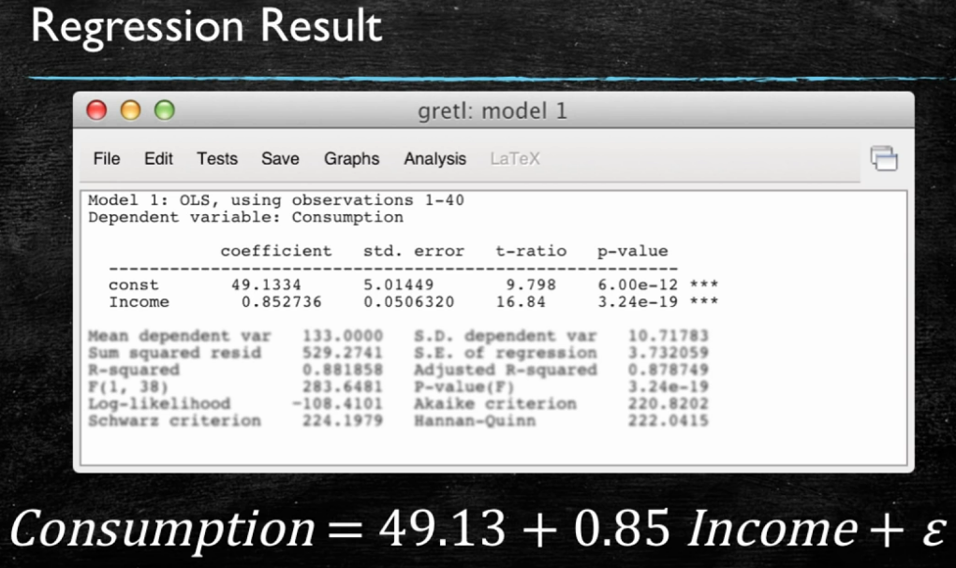

Slide 16
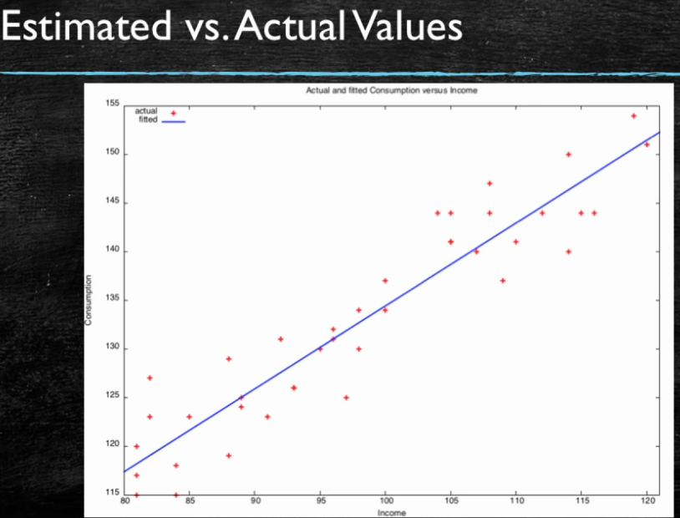

Slide 17
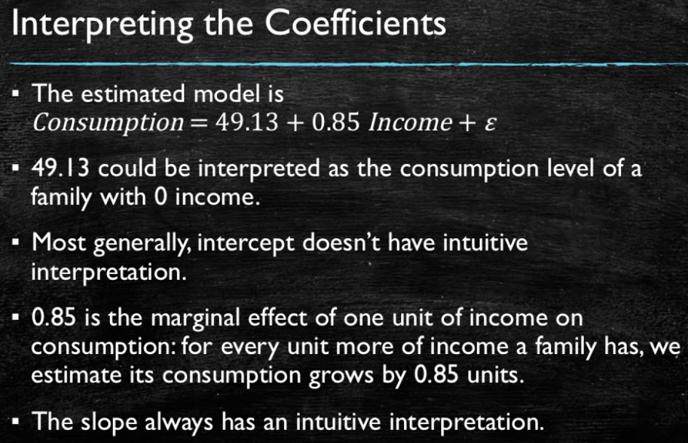

Slide 18
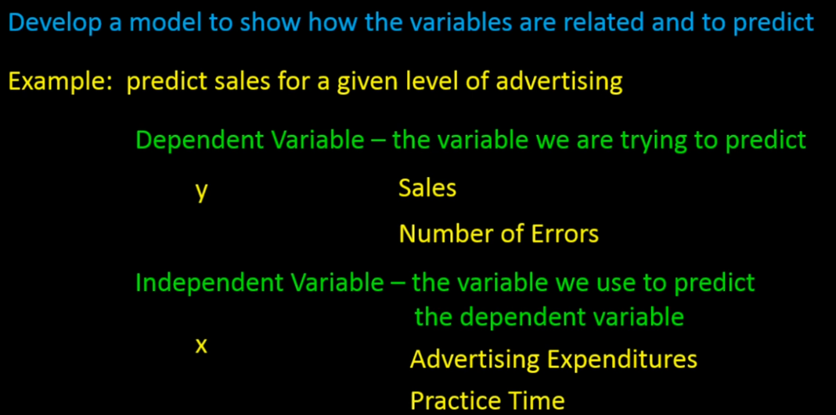

Slide 19
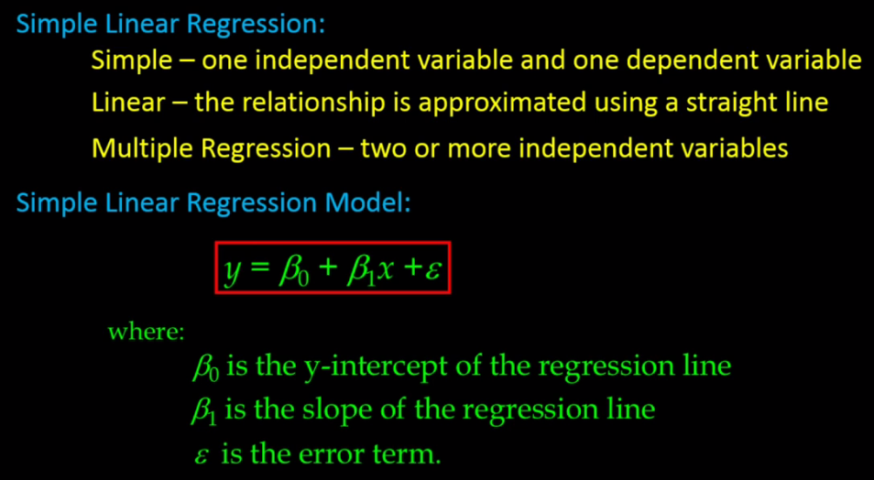

Slide 20
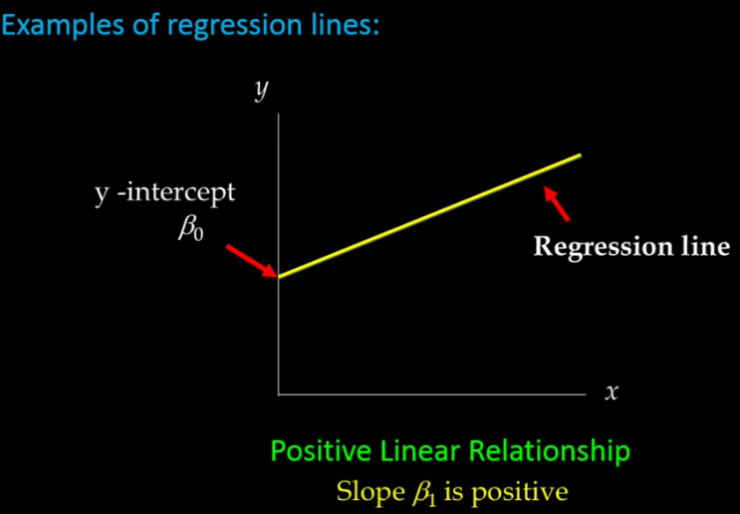

Slide 21
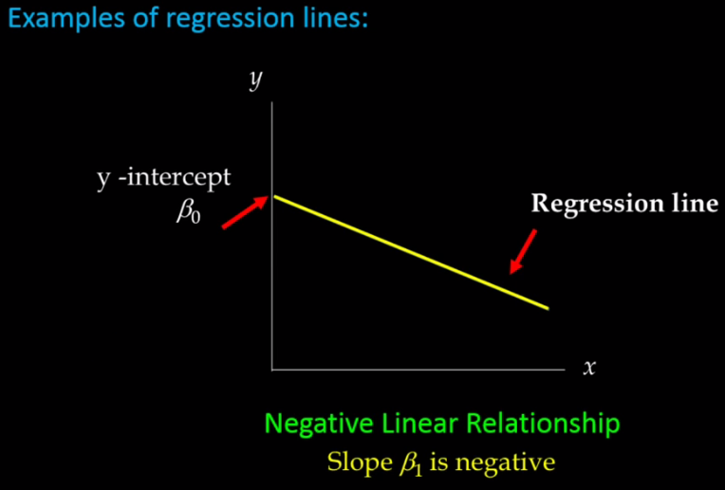

Slide 22
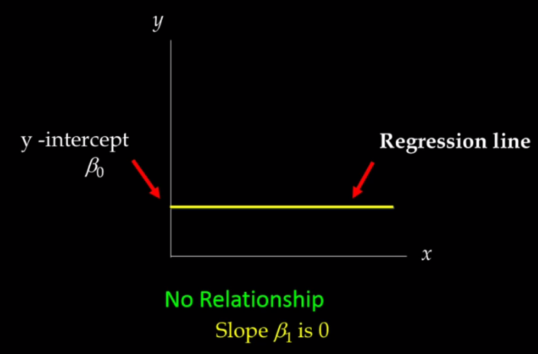

Slide 23
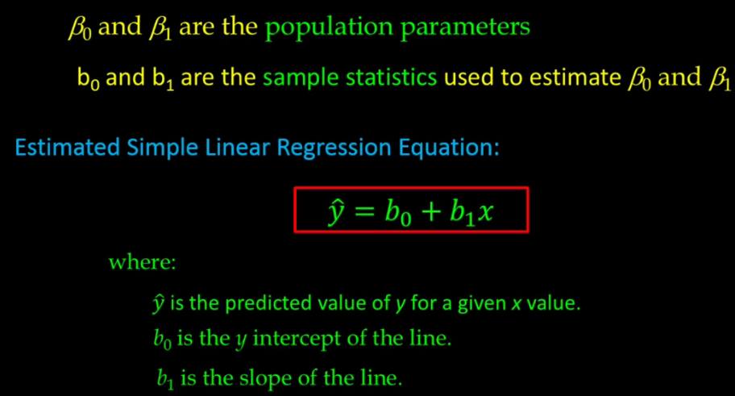


Slide 24
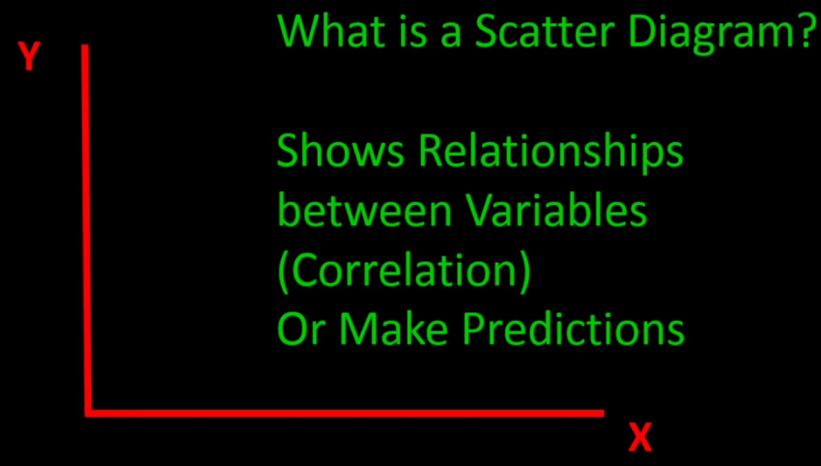

Slide 25
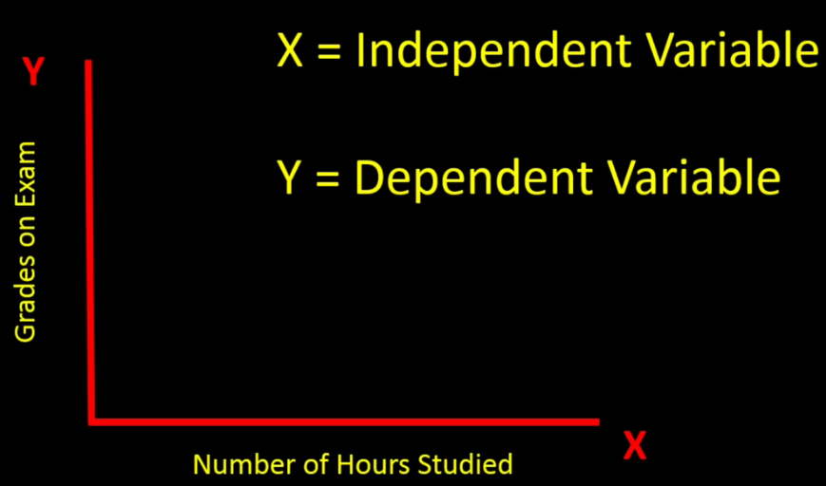

Slide 26
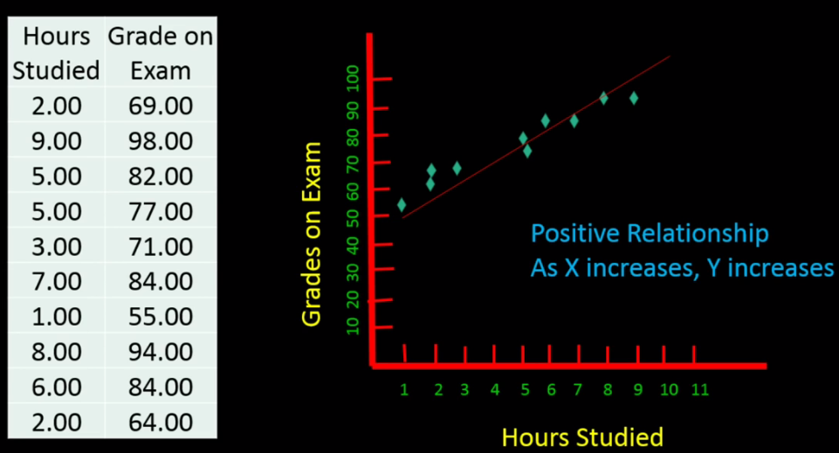

Slide 27
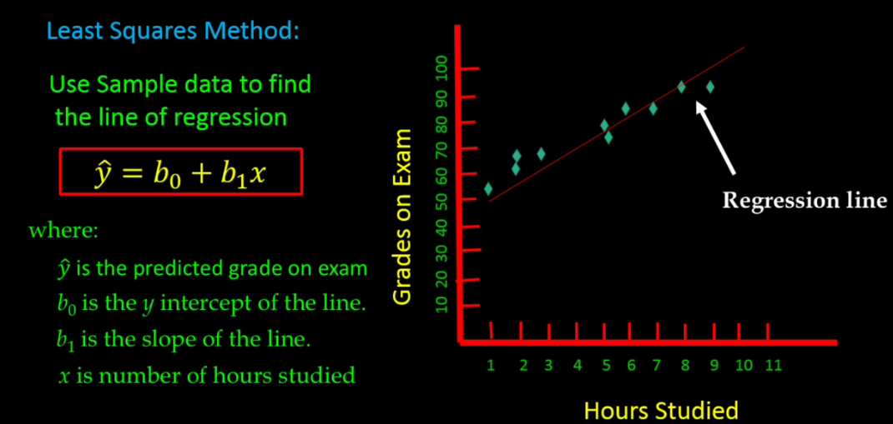

Slide 28
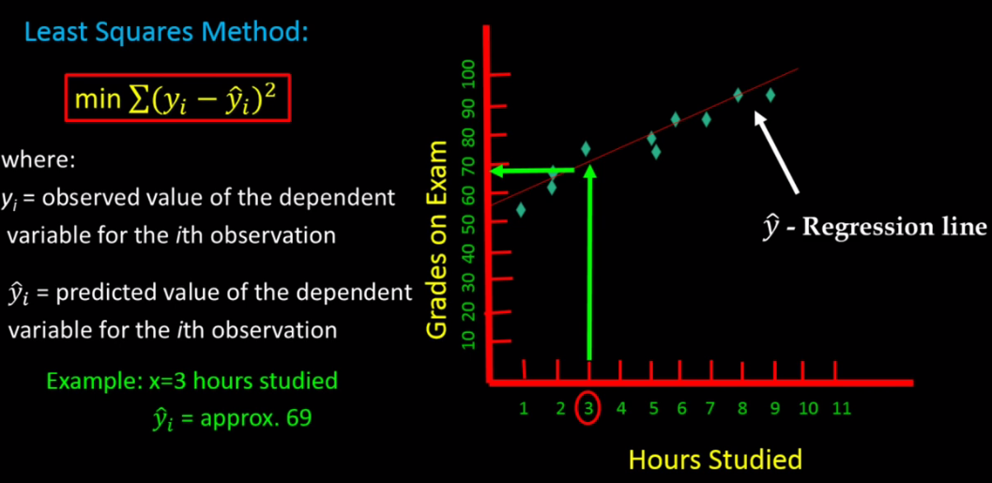

Slide 29
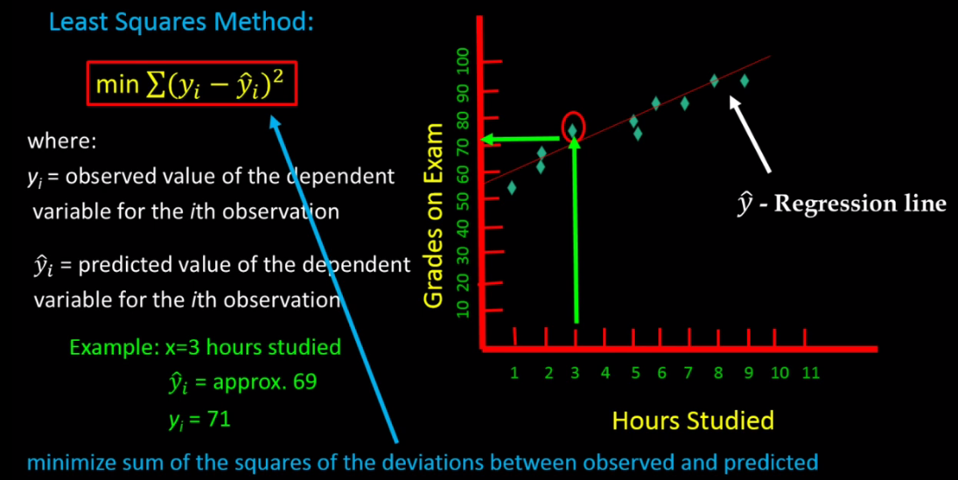

Slide 30
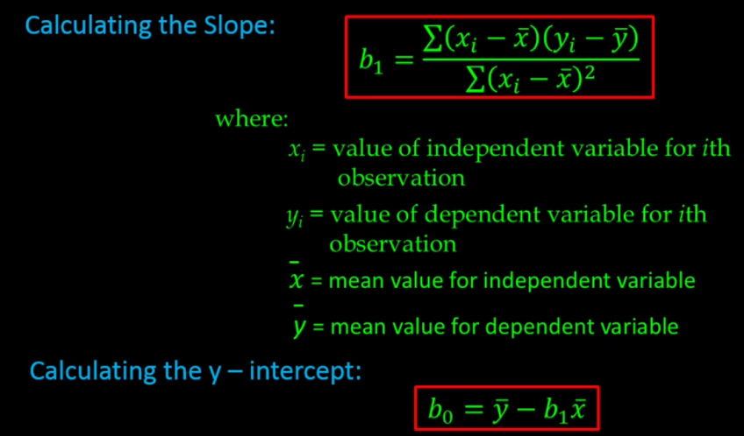

Slide 31
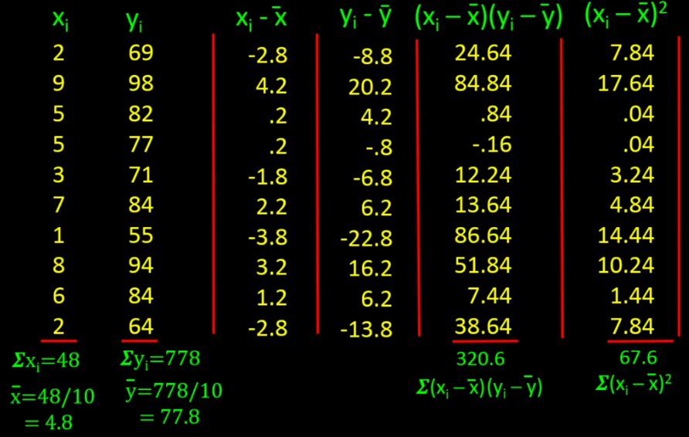

Slide 32
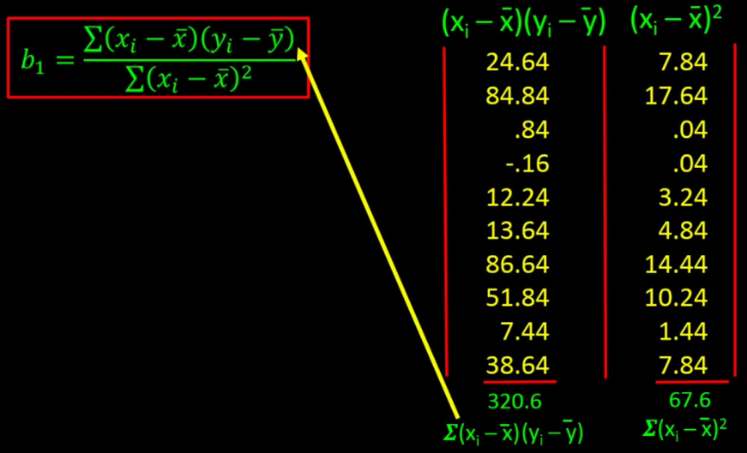

Slide 33
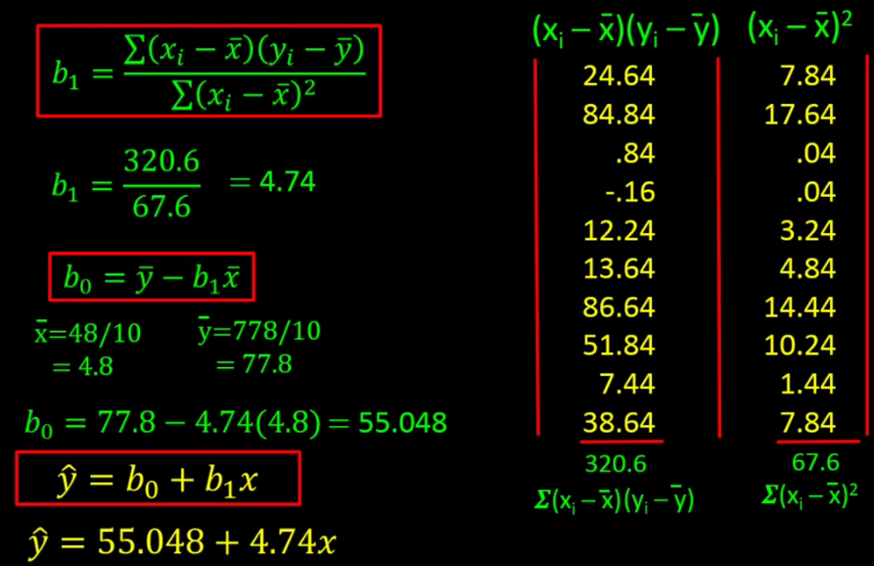

Slide 34
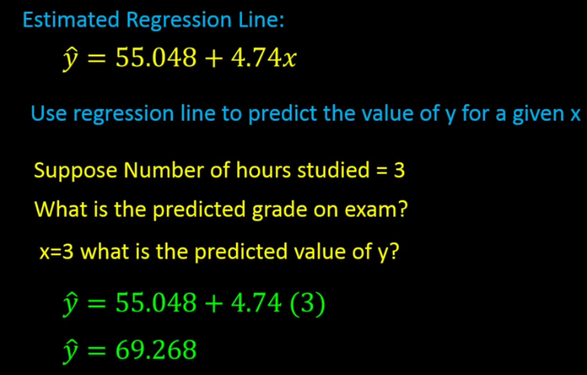

Slide 35
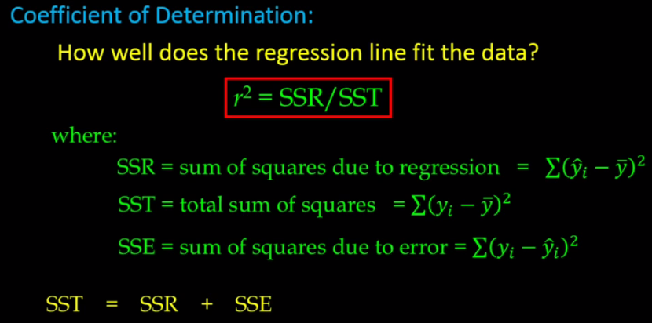

Slide 36
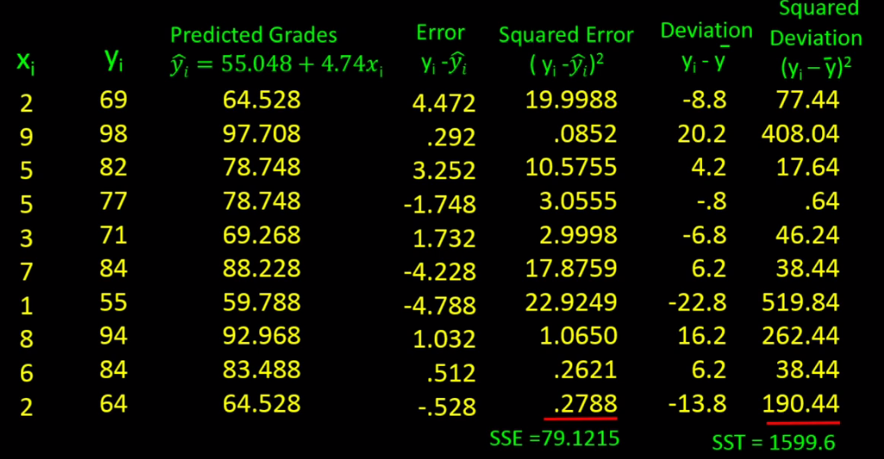

Slide 37
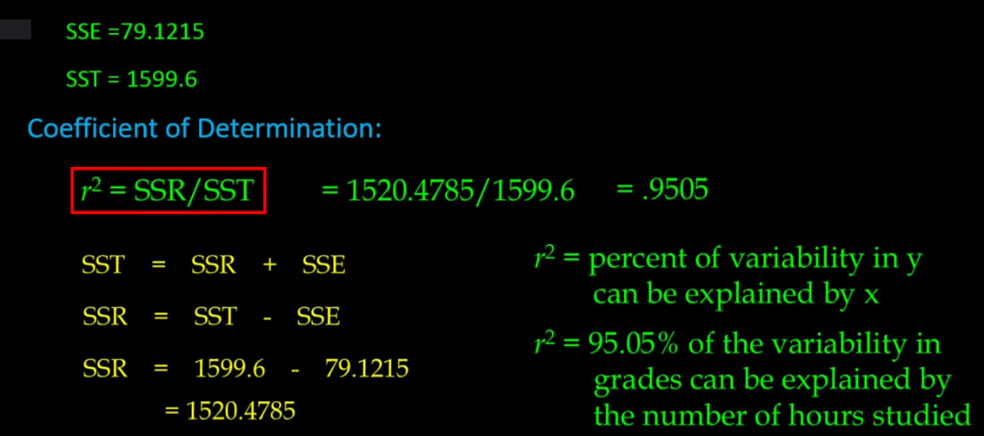

Slide 38
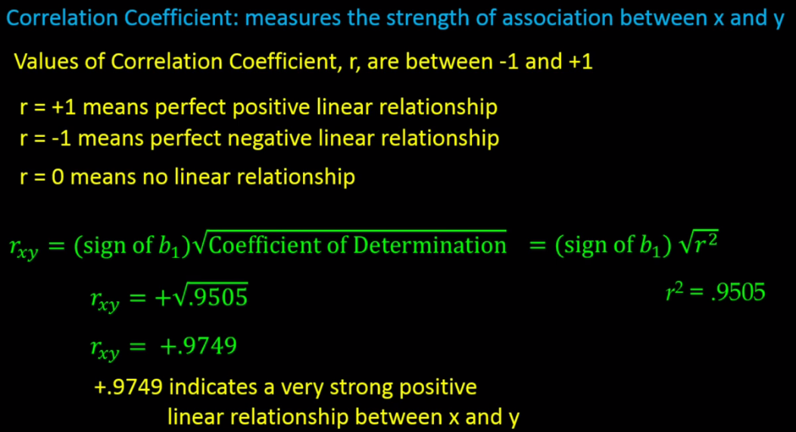

Slide 39
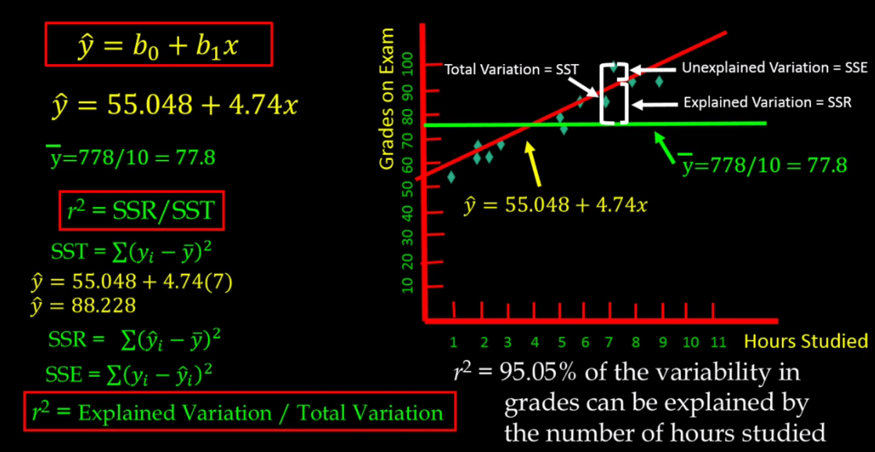

Slide 40
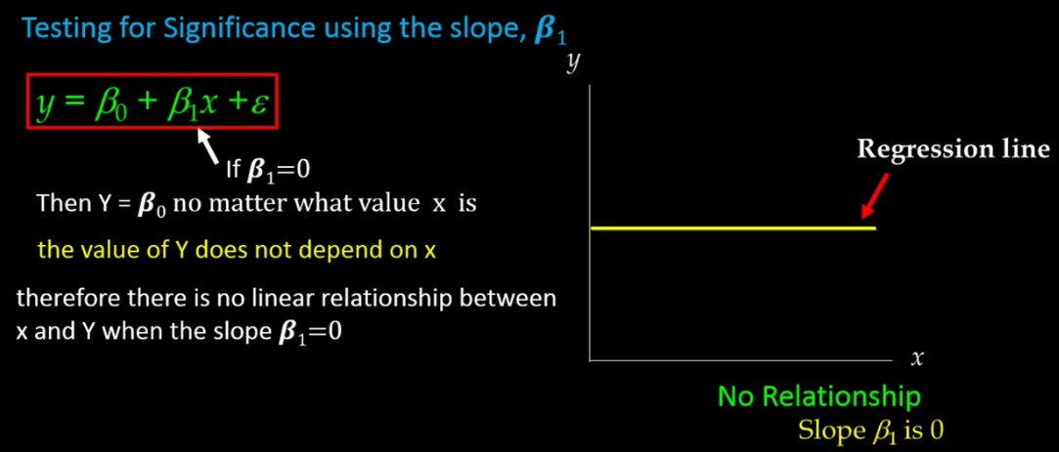

Slide 41
Definition: T-test
A t-test’s statistical significance indicates whether or not the difference between two groups’ averages most likely reflects a “real” difference in the population from which the groups were sampled.
Effect Size (T-Test)
A t-test’s effect size indicates whether or not the difference between two groups’ averages is large enough to have practical meaning, whether or not it is statistically significant.

Slide 42
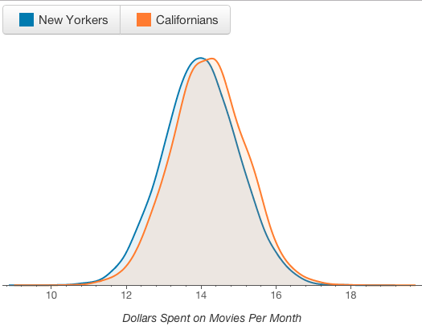

Slide 43
A Statistically Significant T-test result is one in which a difference between two groups is unlikely to have occurred because the sample happened to be atypical.
Statistical significance is determined by:
the size of the difference between the group averages,
the sample size, and
the standard deviations of the groups.
For practical purposes statistical significance suggests that the two larger populations from which we sample are “actually” different.

Slide 44
A t-test asks whether a difference between two groups’ averages is unlikely to have occurred because of random chance in sample selection.
A difference is more likely to be meaningful and “real” if:
(1) the difference between the averages is large,
(2) the sample size is large, and
(3) responses are consistently close to the average values and not widely spread out (the standard deviation is low).

Slide 45
Critical Value Approach
Determining whether or not the observed test statistic is more extreme than would be expected if the null hypothesis were true.
i.e. it entails comparing the observed test statistic to some cutoff value, called the "critical value."
If the test statistic is more extreme than the critical value, then the null hypothesis is rejected in favor of the alternative hypothesis.
If the test statistic is not as extreme as the critical value, then the null hypothesis is not rejected.

Slide 46
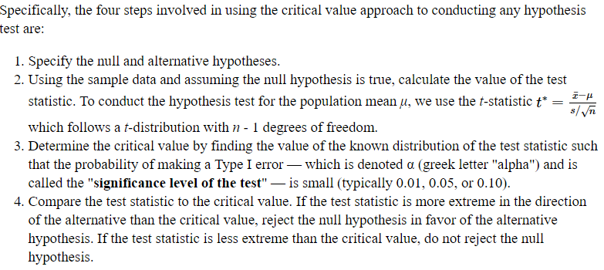
Critical Value Approach

Slide 47
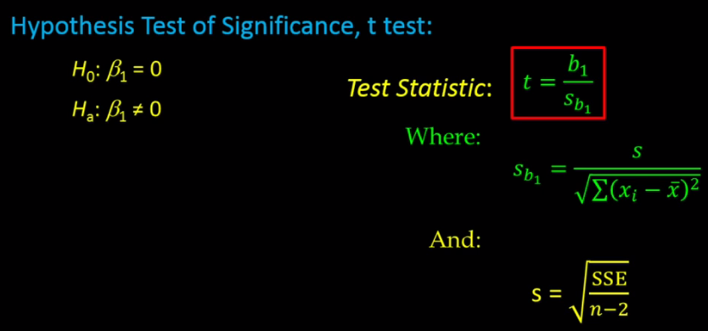

Slide 48
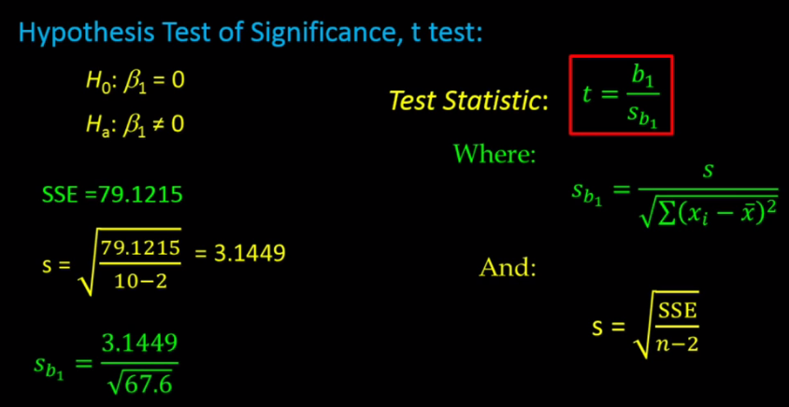

Slide 49
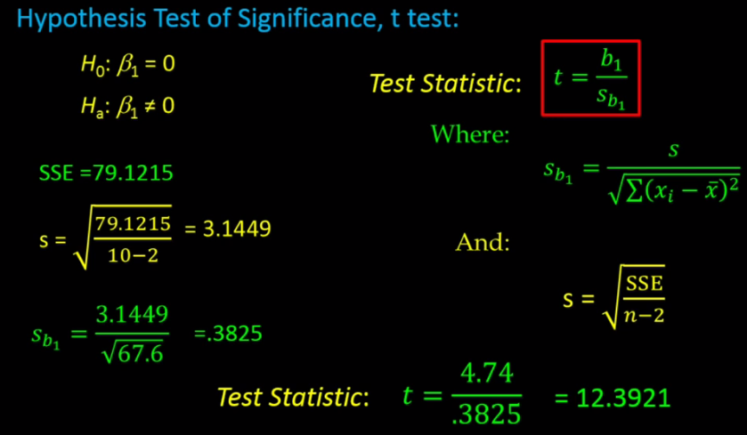

Slide 50
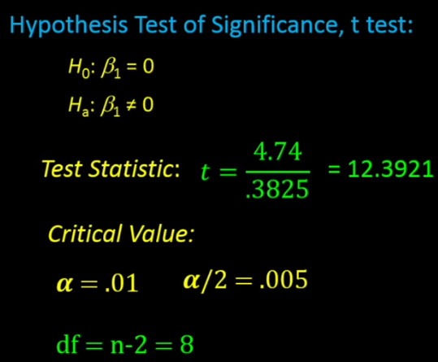

Slide 51
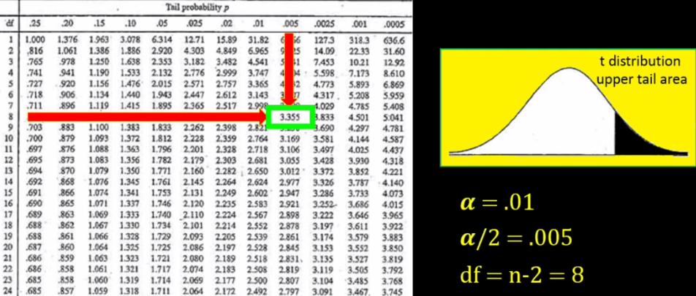

Slide 52
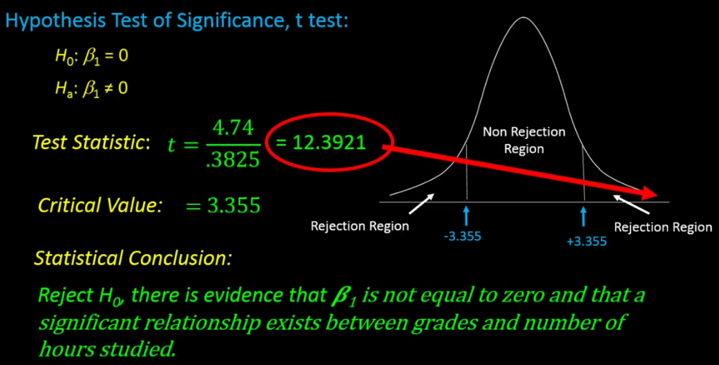

Slide 53
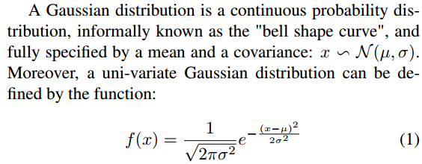

Slide 54
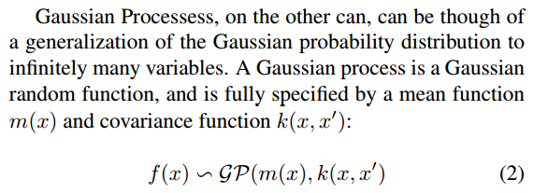

Slide 56
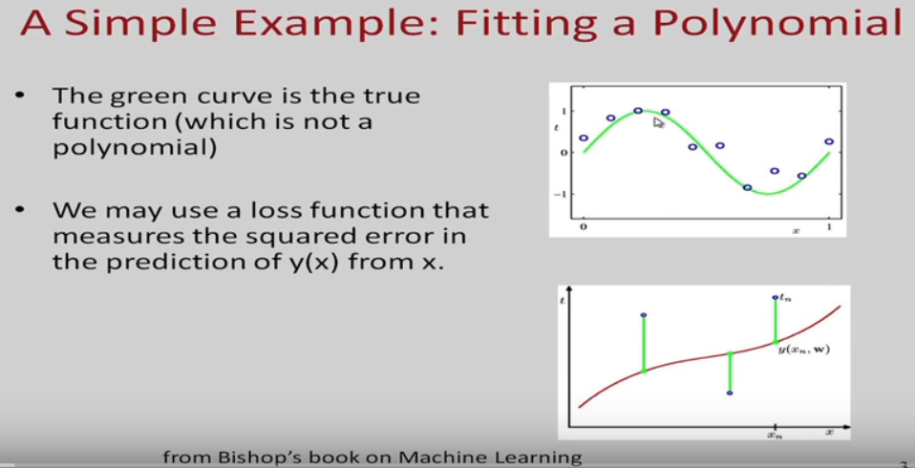

Slide 57
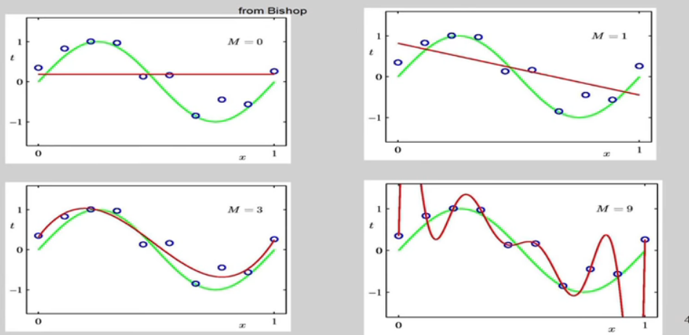
Some fits to the data – Which is the best fit?

Slide 58
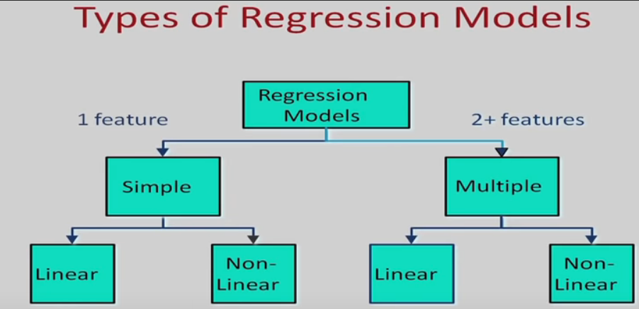

Slide 59
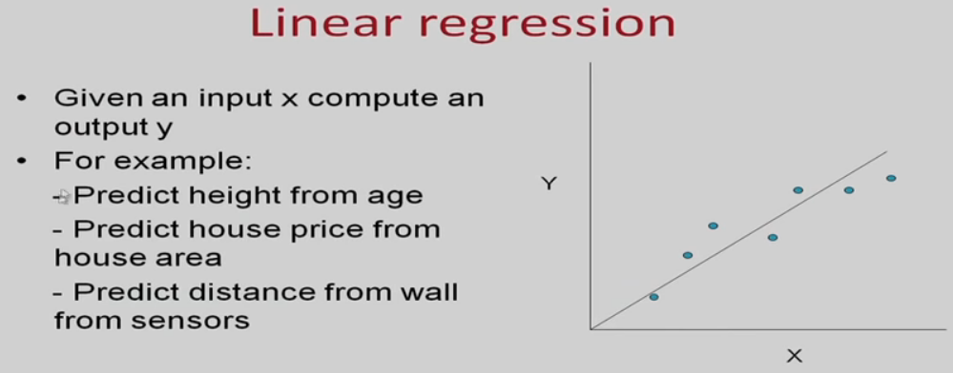

Slide 60


Slide 61


Slide 62


Slide 63


Slide 64


Slide 65


Slide 66


Slide 67


Slide 68


Slide 69


Slide 70


